Slide 1
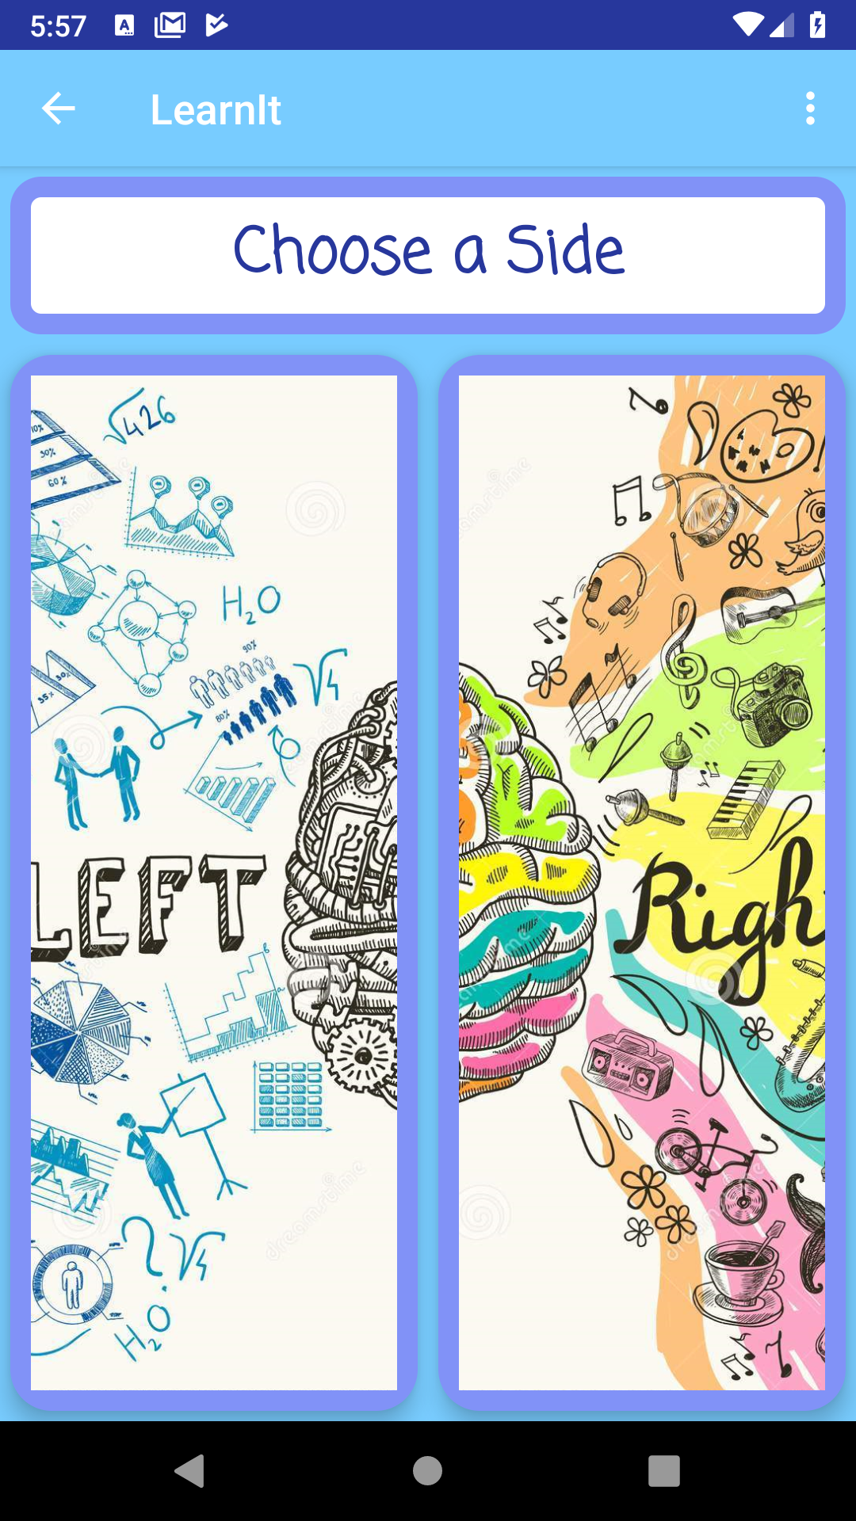
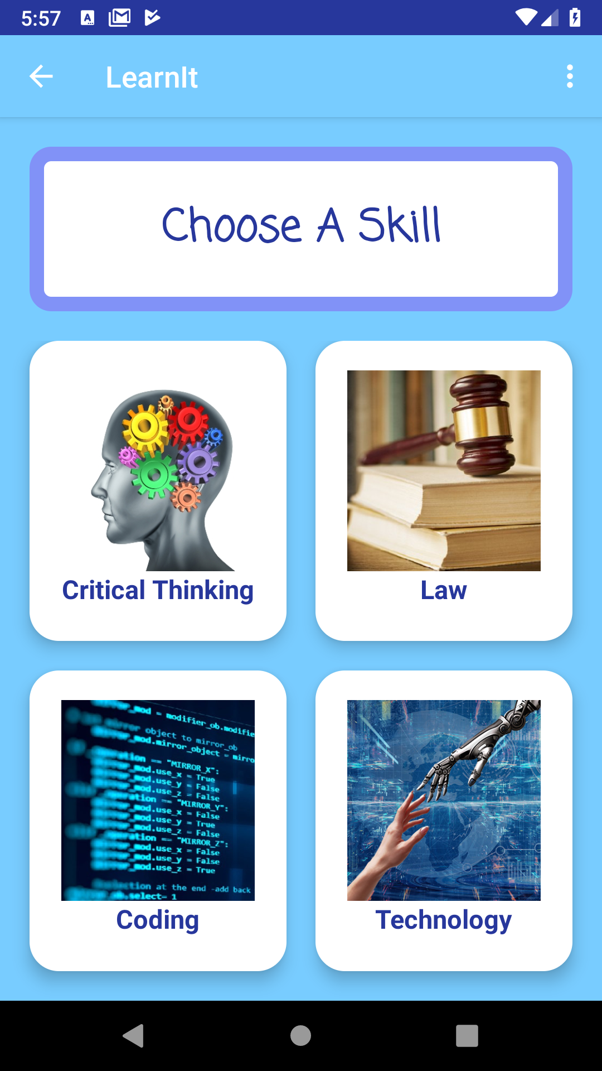
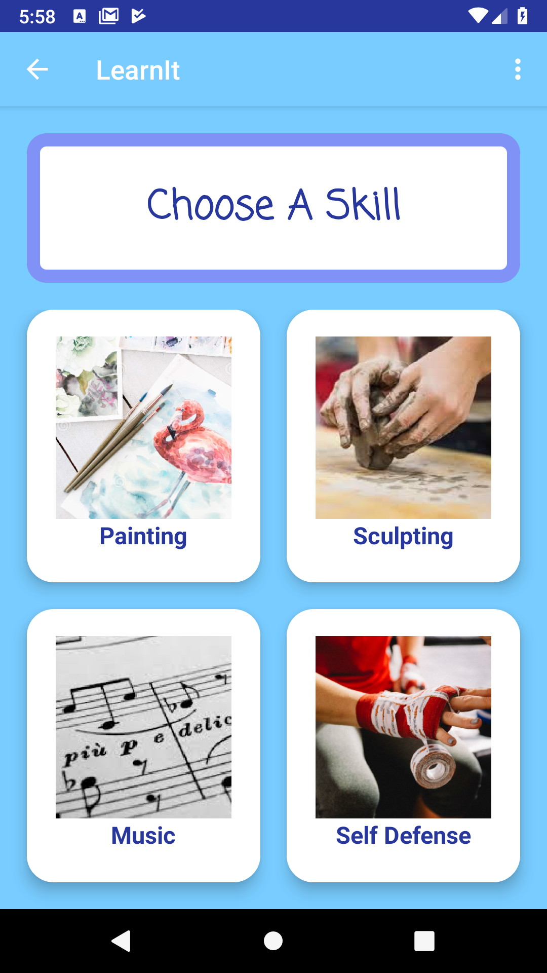
Learnit Presentation
By
Karim Haddad & Loriana G. Maxim
Zubair Janjua & Vlad Epikhin
The App for Your Brain (or at least one half of it)
Learn to be Creative
Learn to be Logical
Learnit

Slide 2
Learnit
LEARNIT is a learning application that facilitates knowledge acquirement about different subjects.
Learnit provides you with a set of free videos and eBooks to learn from, tests your knowledge related to the skills you are learning about, saves your notes about skill progress in an organized manner and shows you the location of the best places to study nearby.

Slide 3
Features
Brain Side
Learn a Skill
Introductory Description & Video
Educational Videos List
Educational EBooks List
Quizzes
Skill Journal
Find-A-Place-To-Study Map

Slide 4
APIs and Technologies
Google Maps API: Shows the map on the app.
Places API: Essential for the finding a study place.
Youtube API: Displays YouTube videos without leaving the app.
JSON: Reading data from the Trivia API.
Open Trivia: Provides quizzes based on category chosen.
SQLite database: Storing Urls of videos and eBooks for each skill.

Slide 5
Feature #1: Brain Side
Skills are categorised by its respective brain side.
The Left Brain Side opens logic related skills.
The Right Brain Side opens creativity related skills.

Slide 6
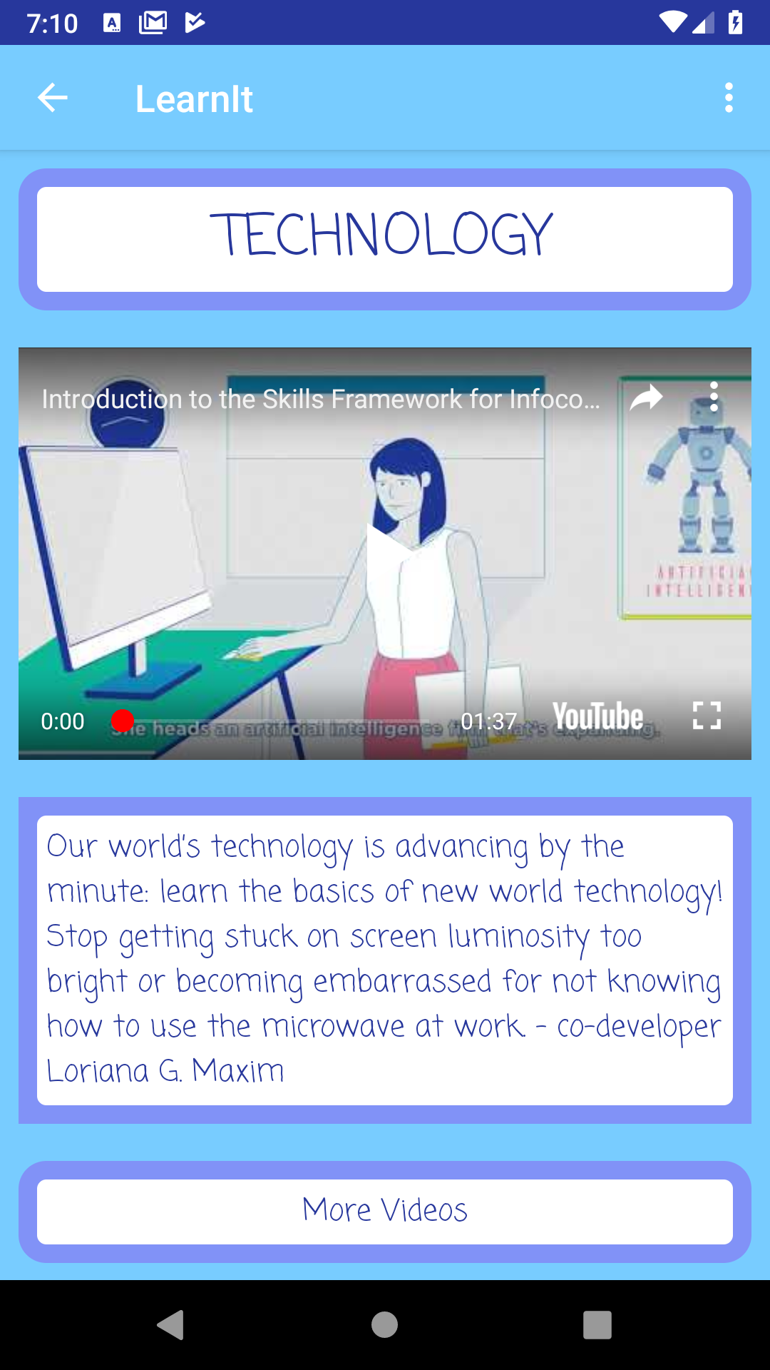
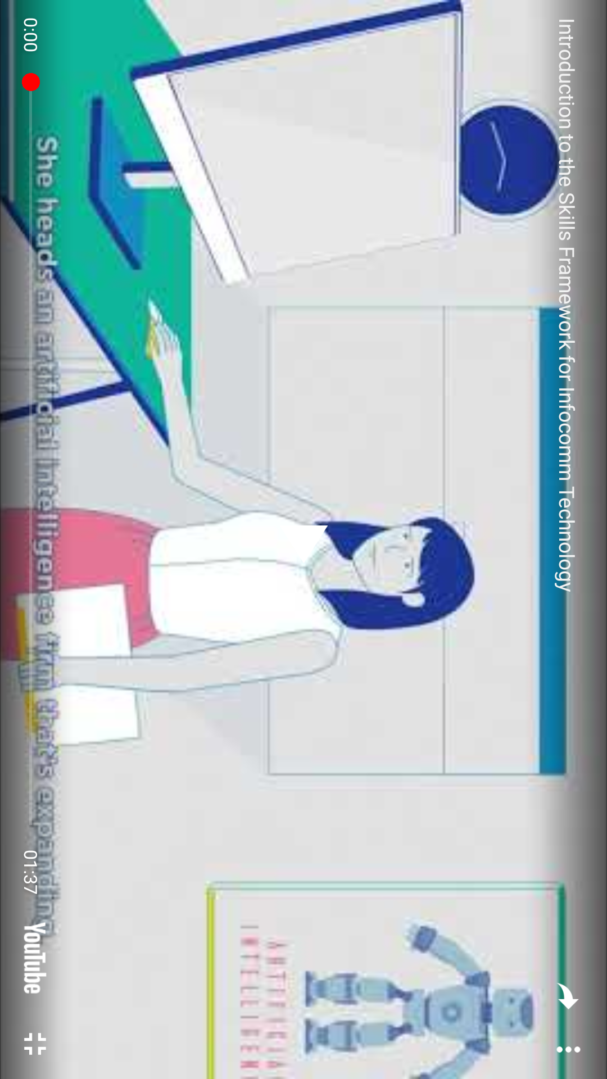
Feature #2: Introductory Description & Video
Video and skill description meant as in introduction to the selected skill.
This feature gives the user an idea of the skill’s contents and context overall.
Video introducing the skill
Skill description
Video can be maximized

Slide 7
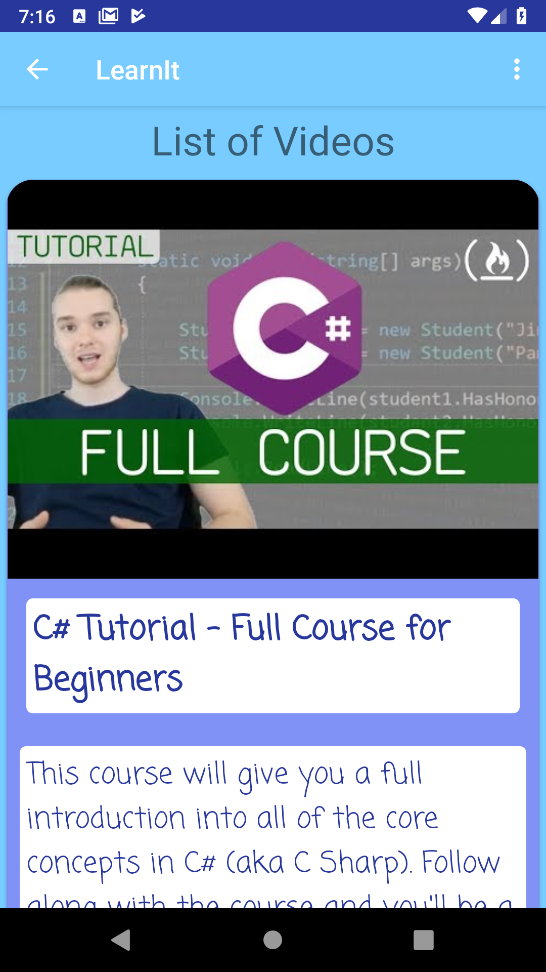
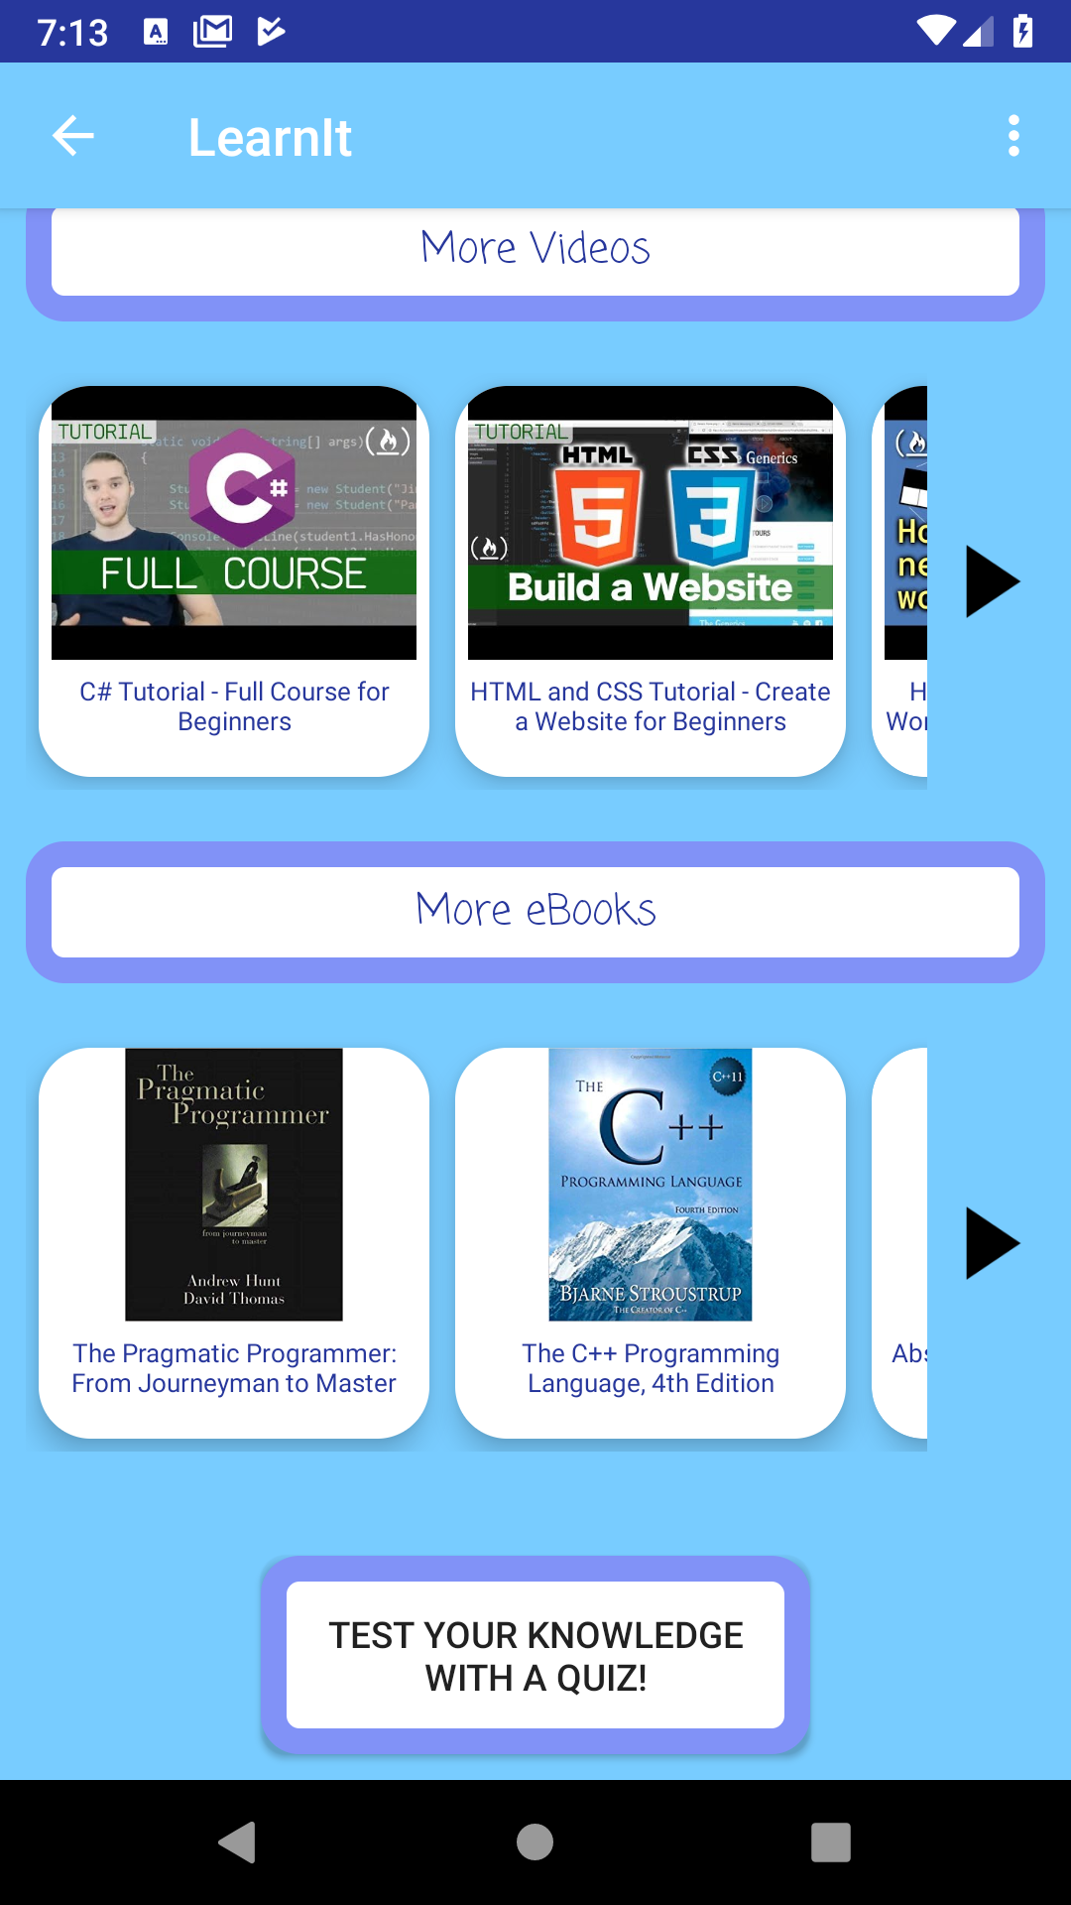
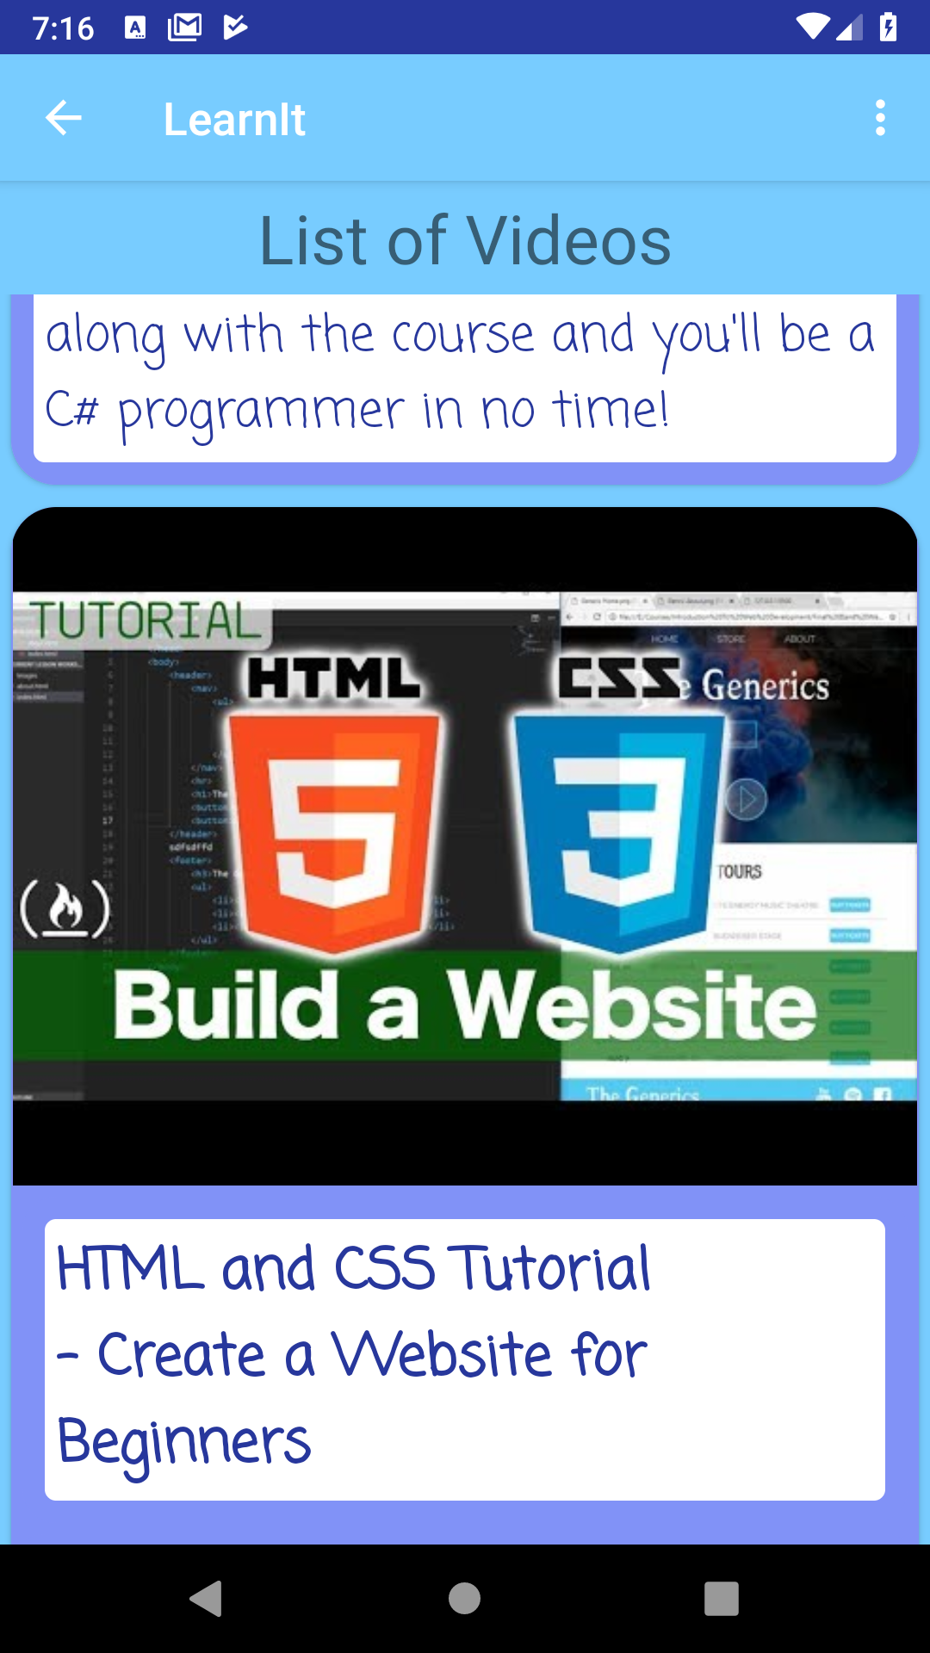
Feature #3: Educational Videos List
List of educational videos related to its corresponding skill.
Describes and explains the skill’s different aspects to the watcher to increase their knowledge on the subject
Meant for the users who learn faster by visualization.

Slide 8
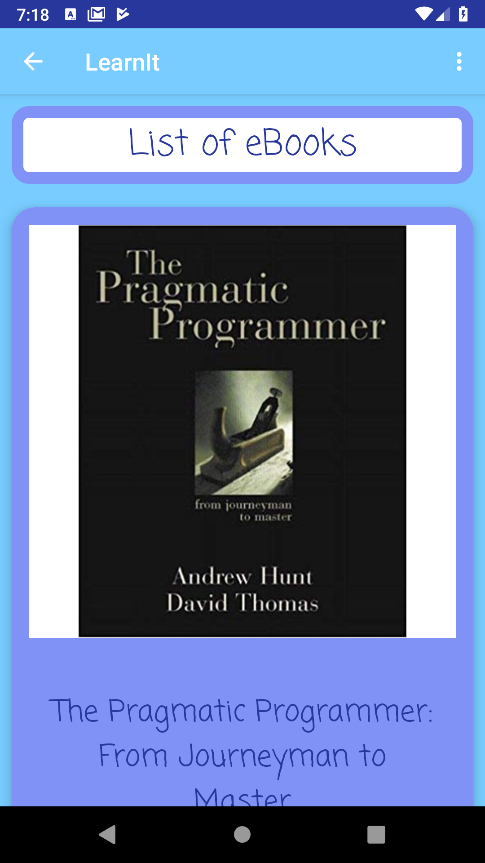
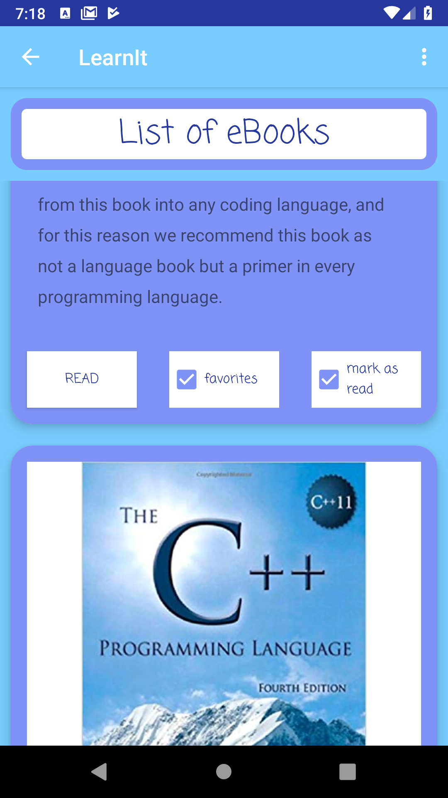
Feature #4: Educational EBooks List
List of educational ebooks related to its corresponding skill.
Explains the skill’s different aspects to increase the reader’s knowledge on the subject.
Meant for the users who learn faster by reading.
EBooks can be favorited or marked as read

Slide 9
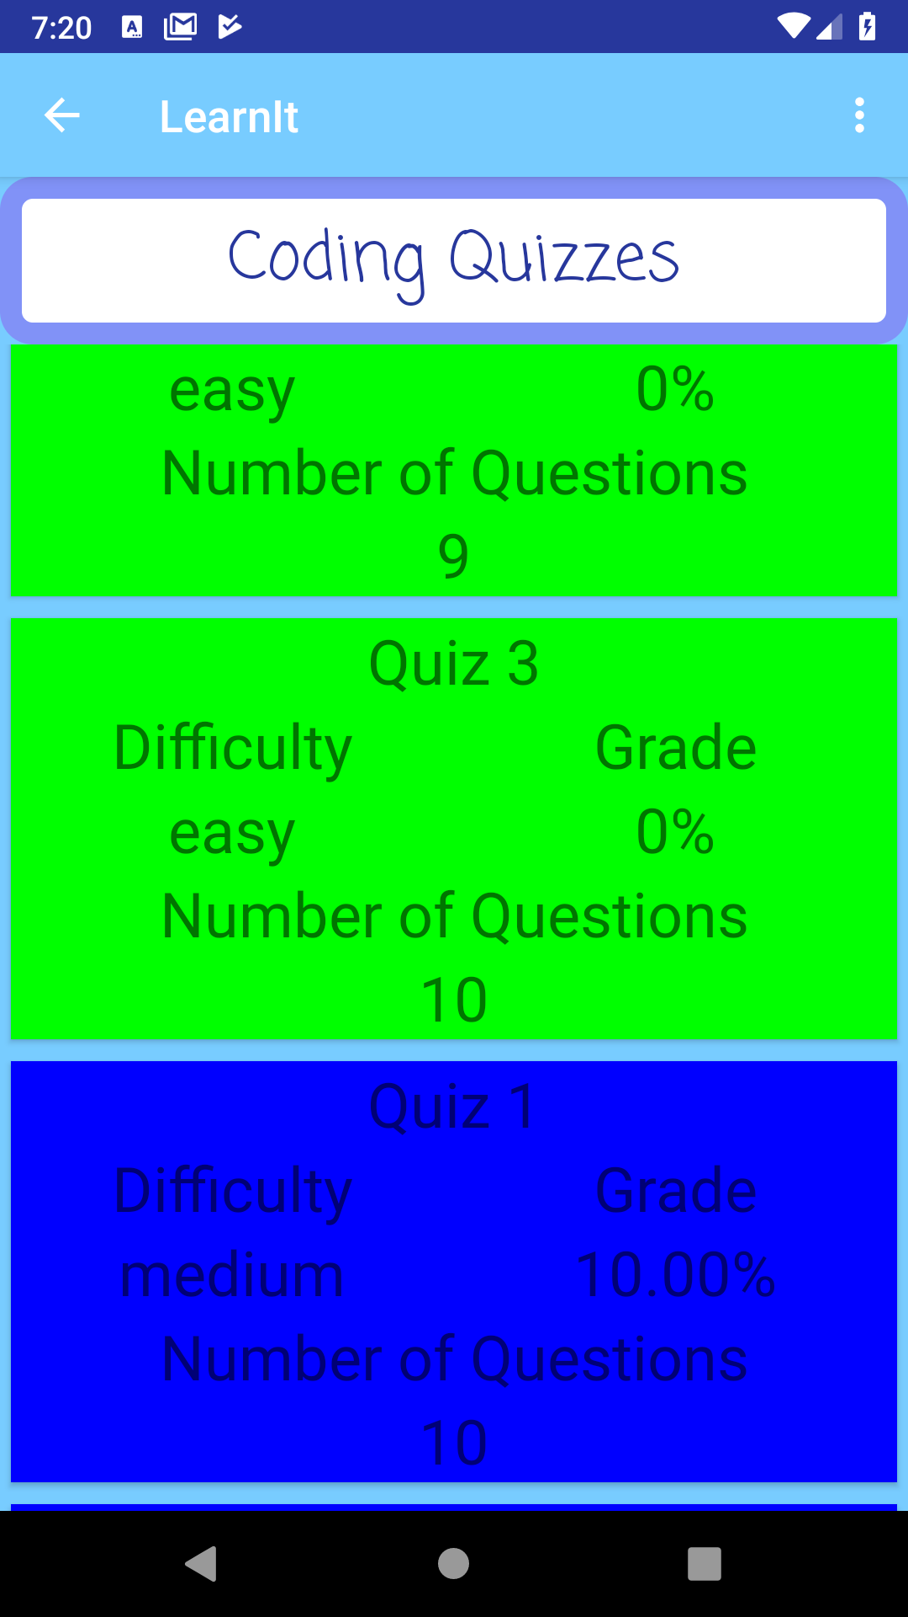
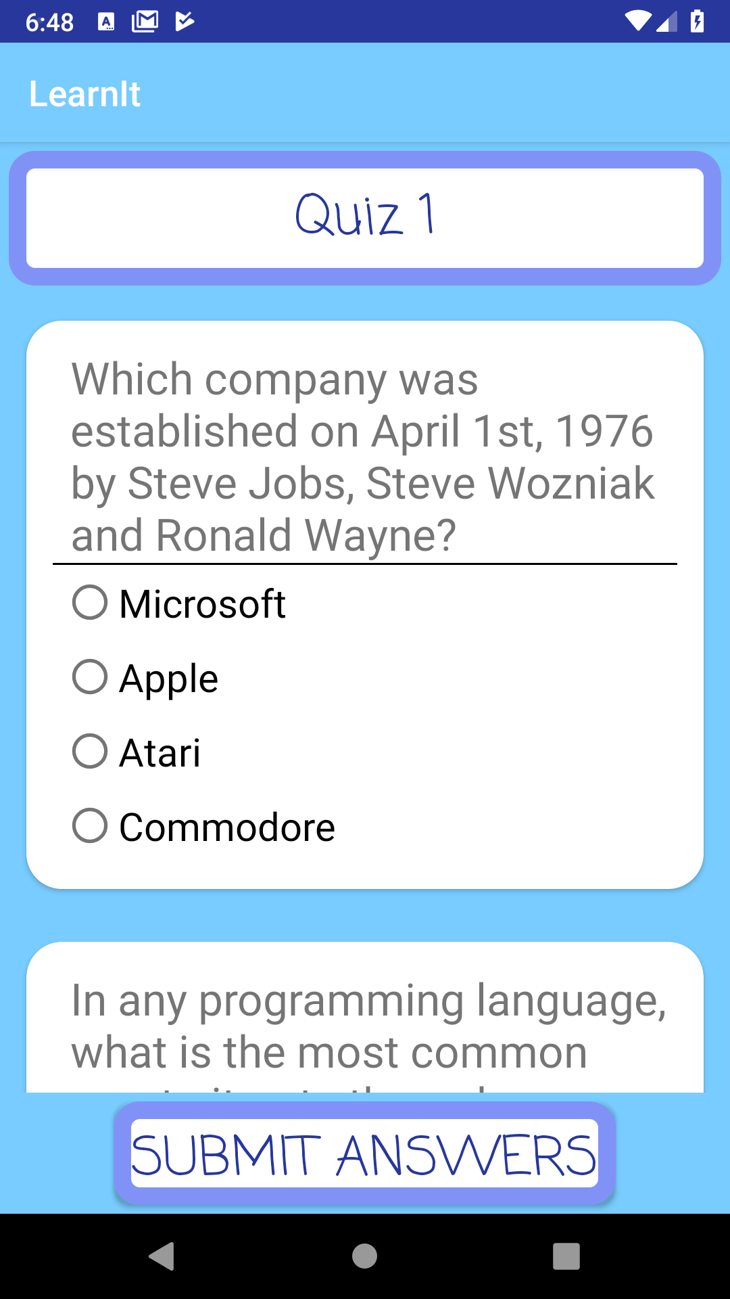
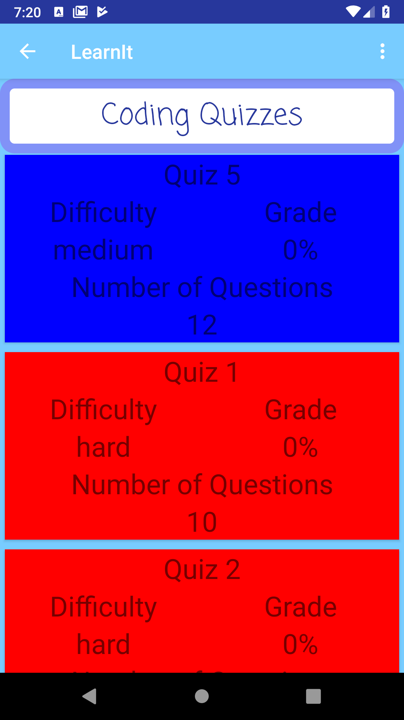
Feature #5: Quizzes
List of quizzes fitted with a level of difficulty.
Tests the user’s acquired knowledge in the respective skill by answering questions related to the content presented in the videos and ebooks.

Slide 10
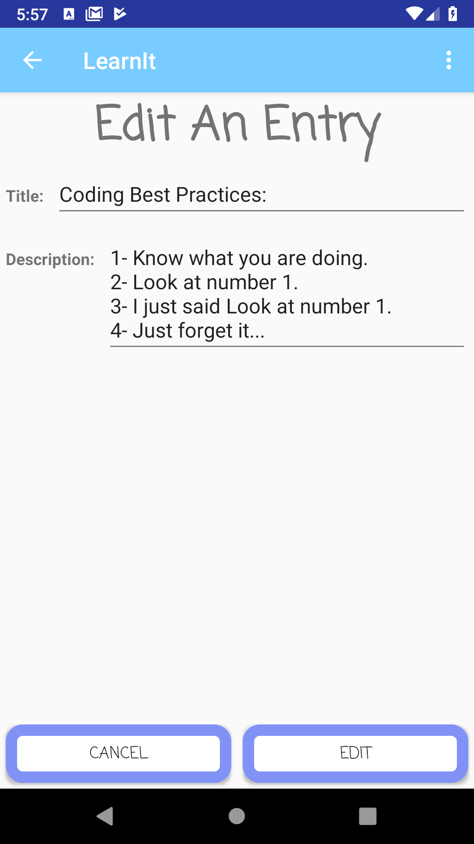
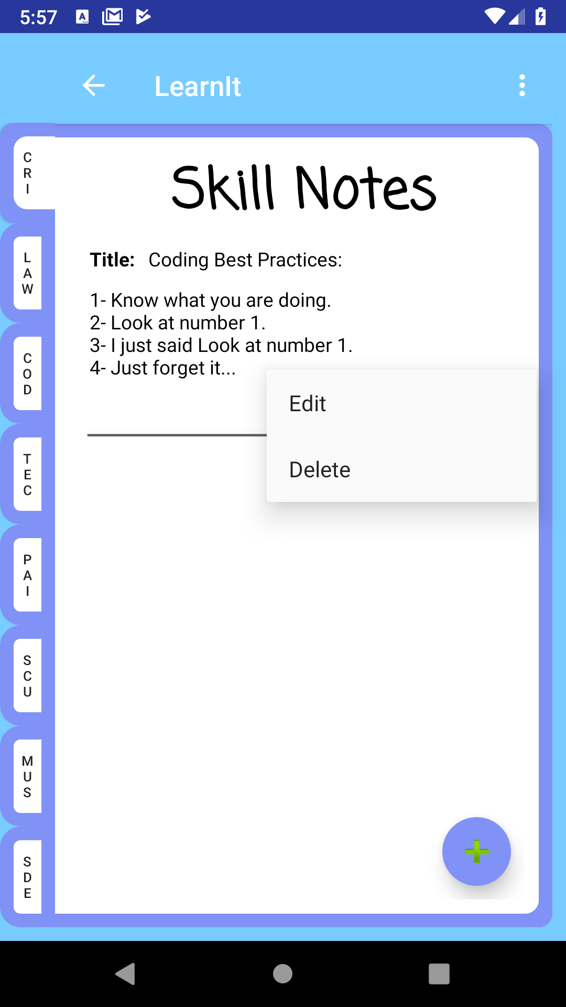
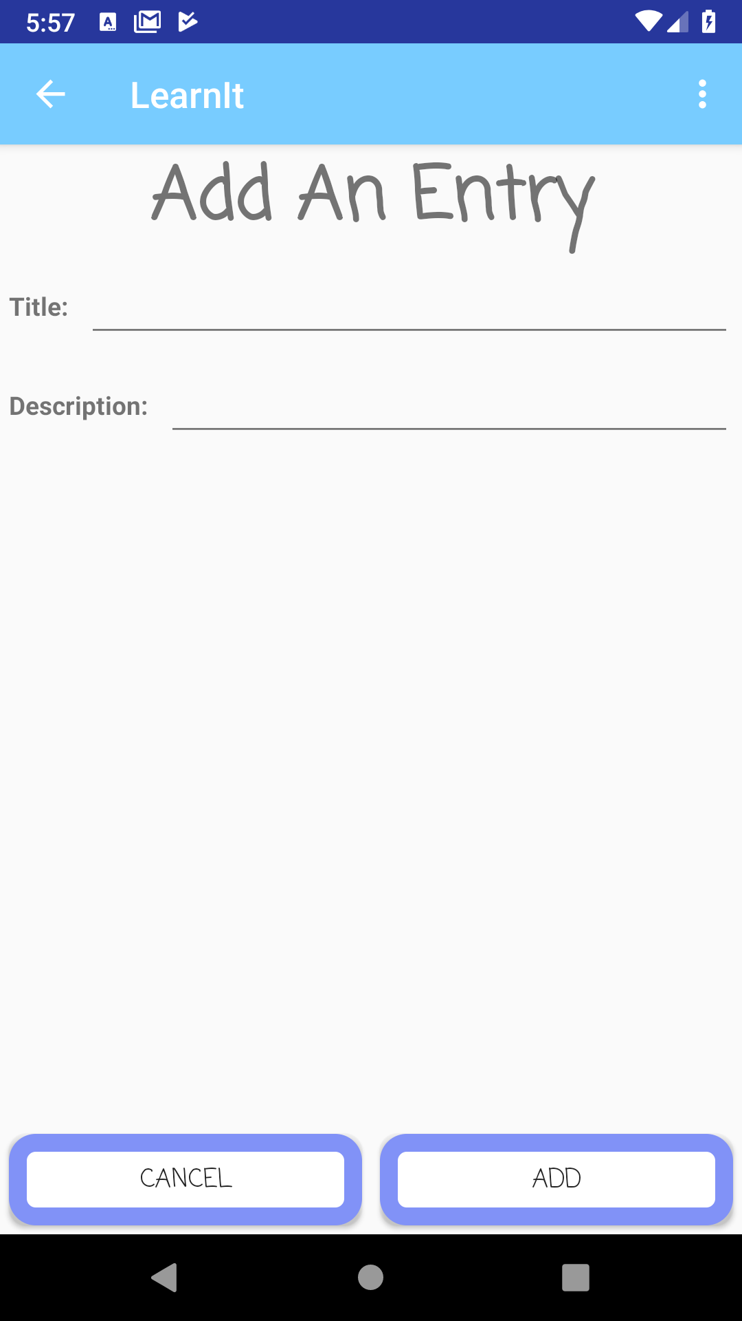
Feature #6: Skill Journal
Journal organized by skill tabs.
The user can add entries related to their personal progress on the different skills.
The entries can be added, edited or deleted.

Slide 11
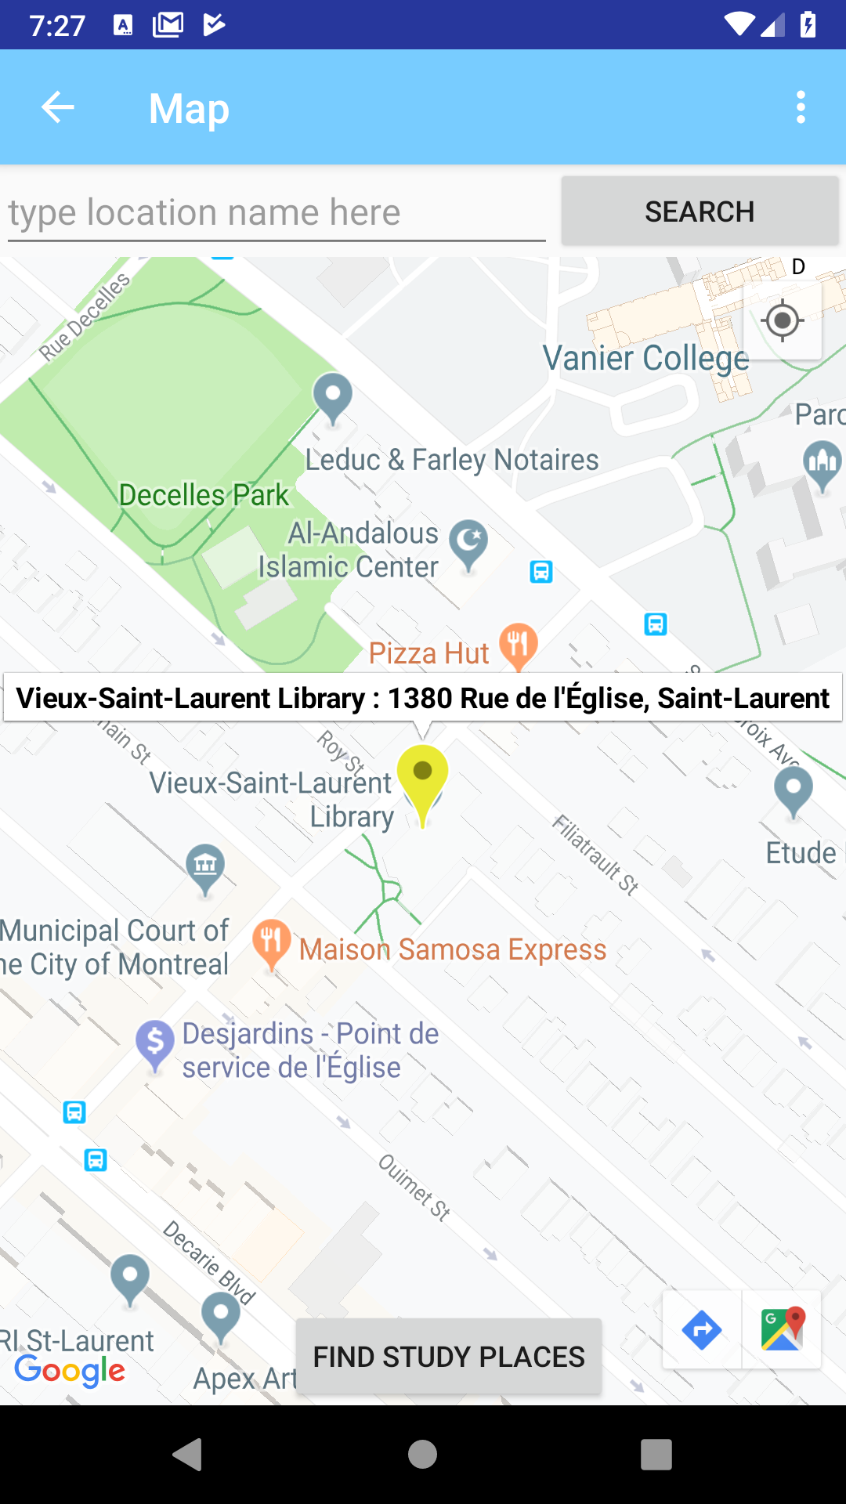
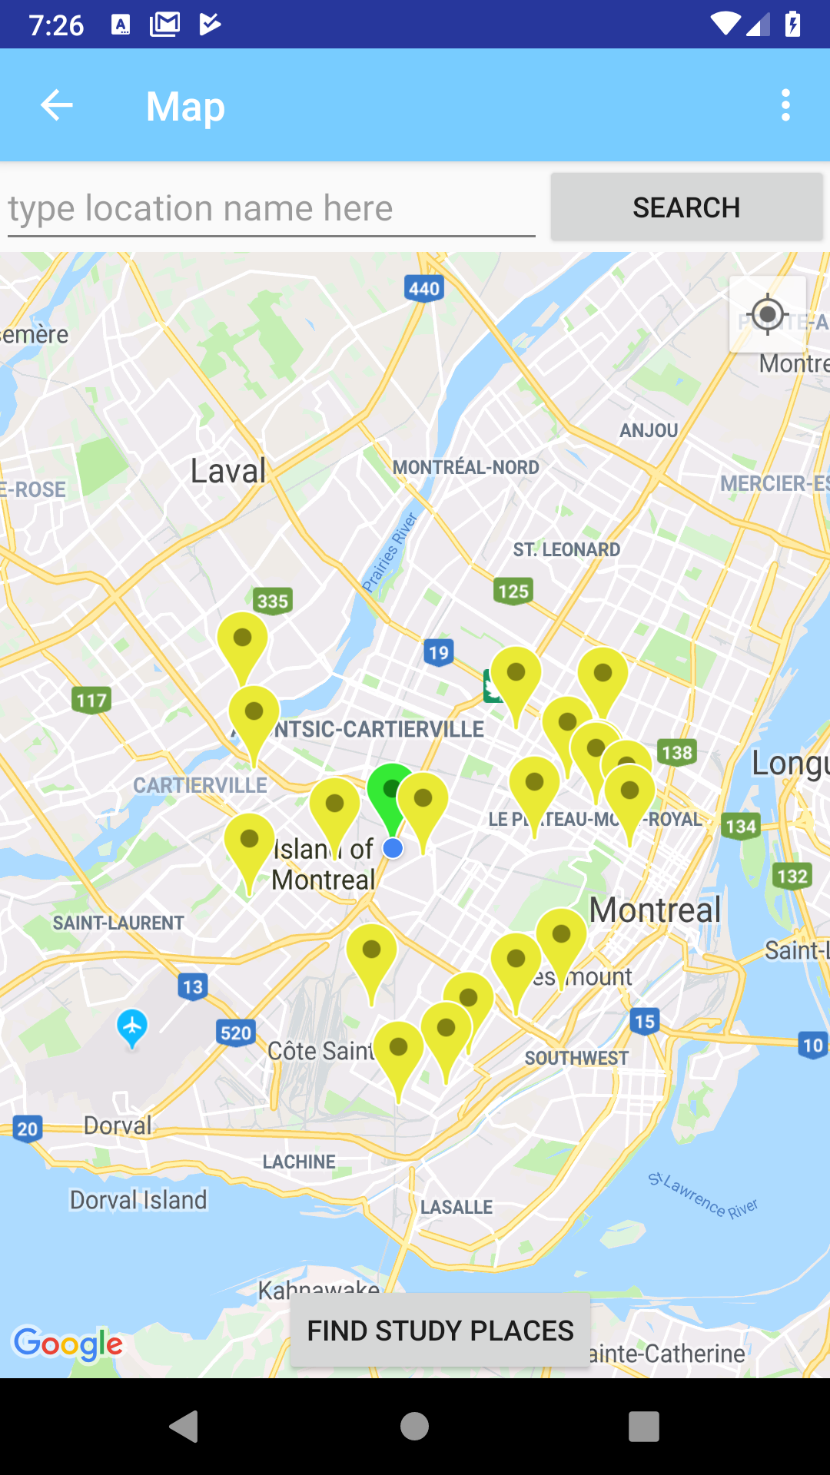
Feature #7: Find-Place-To-Study Map
A Map with the main purpose of locating nearby study places.
The available places can be libraries the user is able reach in order to continue their skill built.

Slide 12

Thank You For Your Attention!
Here’s an android potato

